Slide 1

Ethical Student Hackers
Online Anonymity

Slide 2
Welcome Back!
Hope you all had a lovely break and managed to do something that wasn’t revision related
Today’s session is all about online anonymity
How it can be ‘achieved’
What limitations technologies have
How it can be compromised
We’ll be covering various technologies - VPNs, Tor and I2P
We’ll look at attacks on these anonymity solutions
And we’ll take you through setting up your own
Notes:
Pretty theory-heavy - strap in

Slide 3
The Legal Bit
The skills taught in these sessions allow identification and exploitation of security vulnerabilities in systems. We strive to give you a place to practice legally, and can point you to other places to practice. These skills should not be used on systems where you do not have explicit permission from the owner of the system. It is VERY easy to end up in breach of relevant laws, and we can accept no responsibility for anything you do with the skills learnt here.
If we have reason to believe that you are utilising these skills against systems where you are not authorised you will be banned from our events, and if necessary the relevant authorities will be alerted.
Remember, if you have any doubts as to if something is legal or authorised, just don't do it until you are able to confirm you are allowed to.

Slide 4
Code of Conduct
Before proceeding past this point you must read and agree to our Code of Conduct - this is a requirement from the University for us to operate as a society.
If you have any doubts or need anything clarified, please ask a member of the committee.
Breaching the Code of Conduct = immediate ejection and further consequences.
Code of Conduct can be found at https://shefesh.com/downloads/SESH%20Code%20of%20Conduct.pdf

Slide 5


Anonymity Techs
And how to use them

Slide 6
Basics of Proxies
Proxies create an indirect connection to their destination
Packets are routed towards a proxy server, and forwarded on
Some proxies mask the original source’s IP address (‘anonymous’ proxies) and some preserve them (‘transparent’ proxies)
SOCKS Proxies
Designed to route any kind of traffic at layer 5 (Session layer) or above
Often used for communicating over firewalls; also used by Tor (more on this later)
Doesn’t interpret packets as they come through - just forwards them
Creates a TCP session - therefore supports authentication, and SSH tunneling
HTTP
Creates a brand new, identical request, and sends this
May include an X-Forwarded-For header in a transparent proxy

Slide 7
Uses of Proxies
Bypassing geolocation filters & IP bans (in theory)
Load Balancing & Firewalls
Allows packet inspection
Allows separation from internal network
HTTPS proxies are possible using the CONNECT HTTP verb
Many common tools allow a proxying option, for example to pass traffic to Burp Suite
Curl: -x, --proxy <[protocol://][user:password@]proxyhost[:port]>
WFUZZ: -p localhost:8080 or -p localhost:2222:SOCKS5
SQLMap: --proxy=http://127.0.0.1:8080
Gobuster: -p http://127.0.0.1:8080

Slide 8
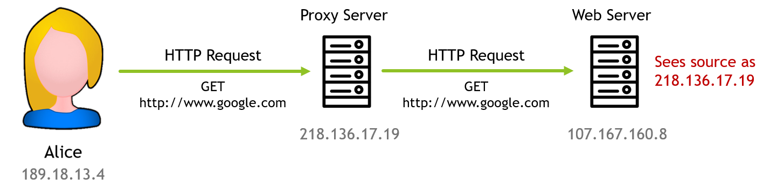
Proxies

Slide 9

Proxies

Slide 10
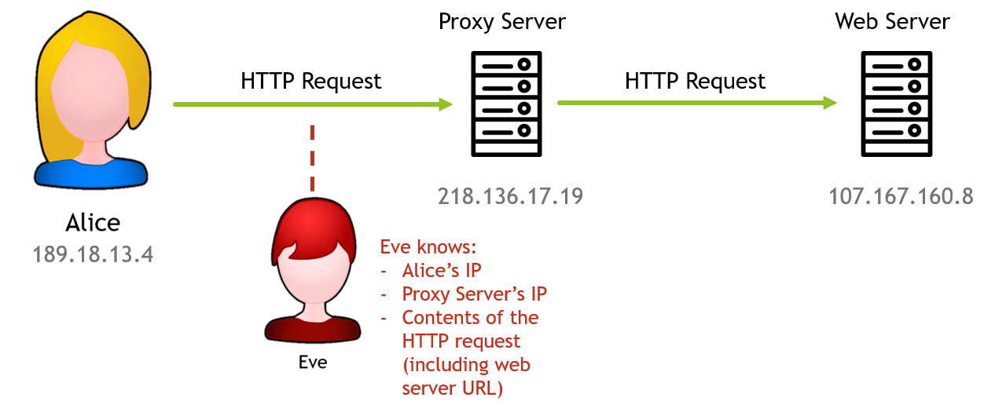
Proxies

Slide 11
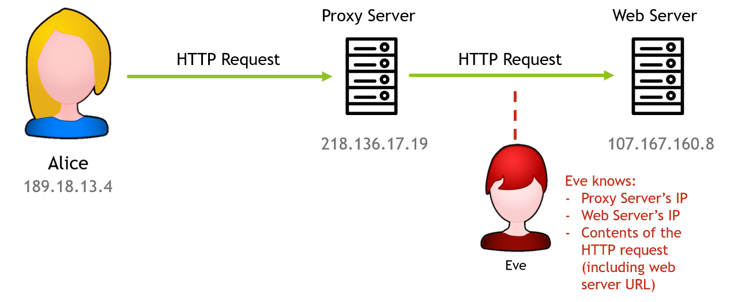
Proxies

Slide 12
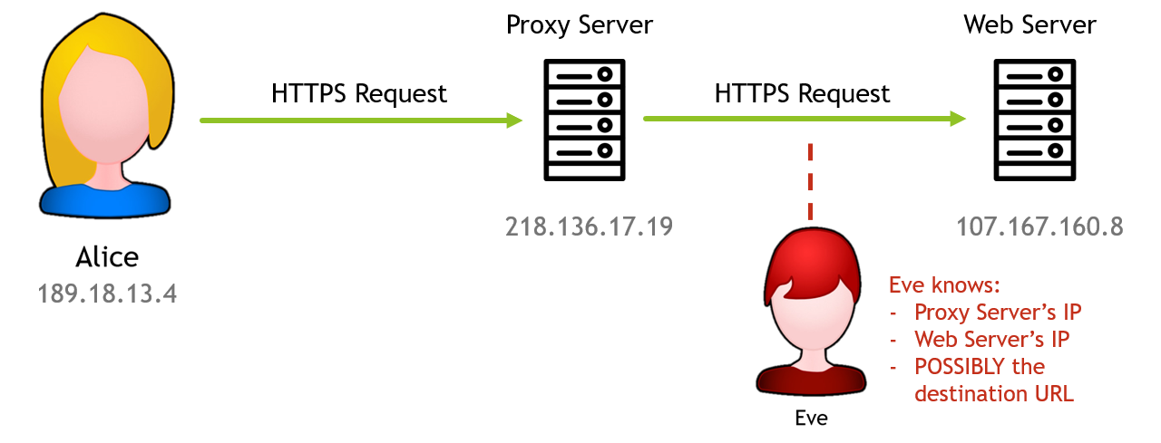
Proxies

Slide 13
Virtual Private Networks (VPNs)
Similar to a proxy (i.e. masking IPs), but with a couple of key differences
Connections to the VPN server are encrypted
They commonly catch all traffic from a host, rather than a specific protocol
Some VPNs encrypt the contents of packets
Tunneling Protocol
The core feature of a VPN - extends a private (non-routable) network over a public one, like the internet, to keep data secure
‘Encapsulates’ packets - the true contents of the packet is hidden all the way to the VPN server, sometimes even hiding details of the traffic type itself
When the traffic reaches the VPN server it is forwarded - the destination sees the VPN as the source
This prevents 3rd parties, including the ISP, from seeing the contents of a packet before it reaches the VPN server

Slide 14
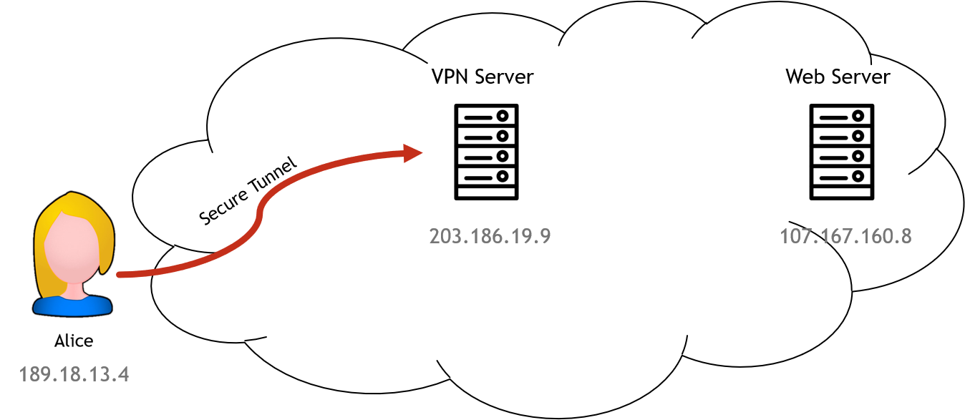
Virtual Private Networks (VPNs)

Slide 15
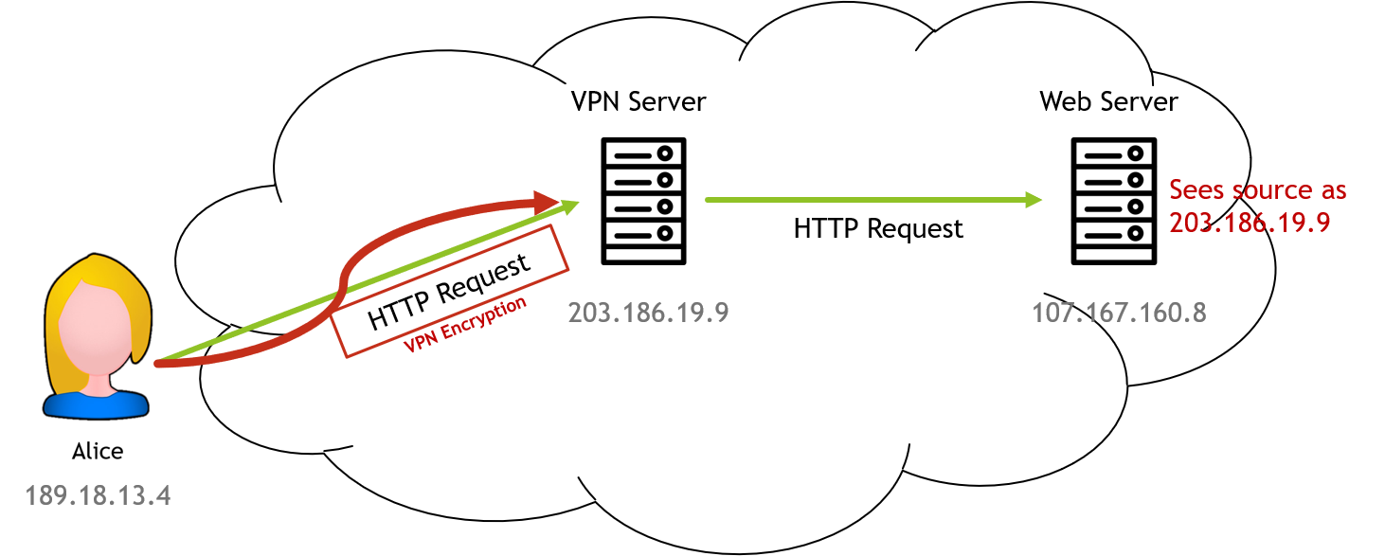
Virtual Private Networks (VPNs)

Slide 16
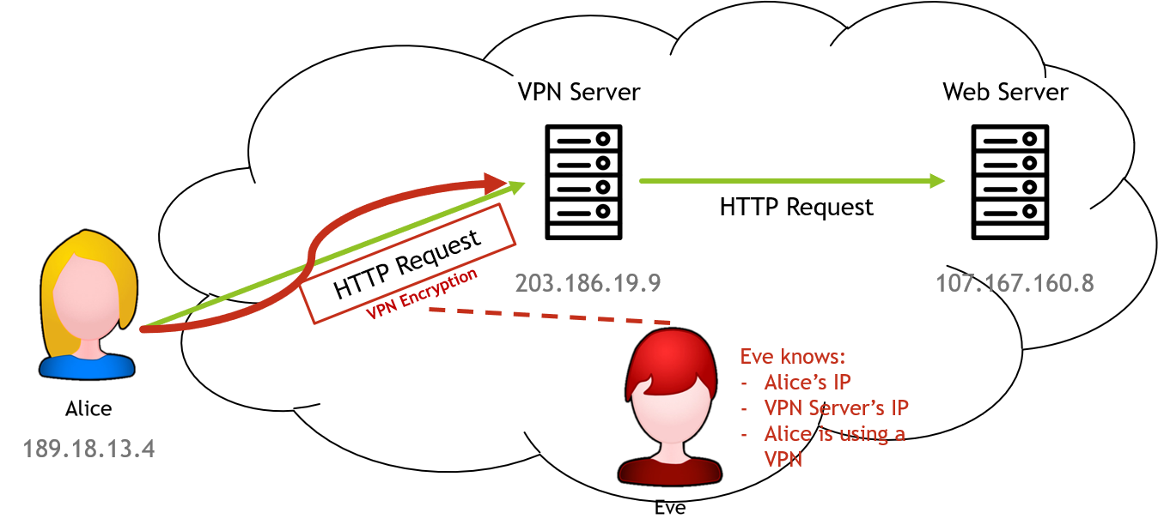
Virtual Private Networks (VPNs)

Slide 17

Virtual Private Networks (VPNs)

Slide 18
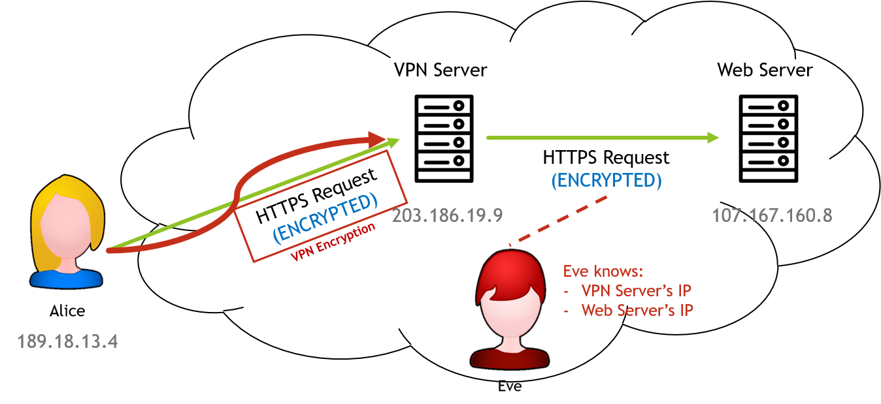
Virtual Private Networks (VPNs)

Slide 19
Attacks Against VPNs & Proxies
Traffic analysis
Analysing grouping and timing of packets (some attacks require visibility of both endpoints)
Fingerprinting traffic based on unencrypted headers (such as browser window size)
Compromised VPN Providers
Traffic Interception
Traffic is unencrypted after leaving the VPN server
MITM attacks could, in theory, impersonate your VPN provider, or a HTTPS proxy by generating on on-the-fly certificate (https://security.stackexchange.com/questions/2914/can-my-company-see-what-https-sites-i-went-to)
Blacklisting
Scraping proxy sites

Slide 20
Mitigations and OpSec
Operational Security
Kill Switches can be used to prevent mistakes from users
VPNs can’t protect you if you leak your personal information in some other way
Extra Encryption
Using HTTPS over a VPN or Proxy can mitigate the effects of traffic interception
Strong Encryption
The better encryption algorithm a provider uses, the safer you are

Slide 21
The Onion Router (Tor)
Onion Routing - another way of creating indirect connections from source to destination
A Tor ‘circuit’ consists of many relay nodes (minimum three in theory, exactly three in practice)
Packets are encrypted multiple times, according to the number of relay nodes
Each relay node decrypts one layer of encryption, revealing the address of the next
The final (‘exit’) node reveals the destination address and contents of the packet
On the way back, each node re-encrypts the packet and passes it to whichever node sent it to them the first time
Nodes are picked according to several rules which seek to lower the chance of endpoint attacks - for example, never picking the same node twice
Because of this, there is no one point of compromise in the network
Even a malicious node cannot get a complete picture of the traffic
For a detailed description of all things Tor, see this link: https://skerritt.blog/how-does-tor-really-work/

Slide 22
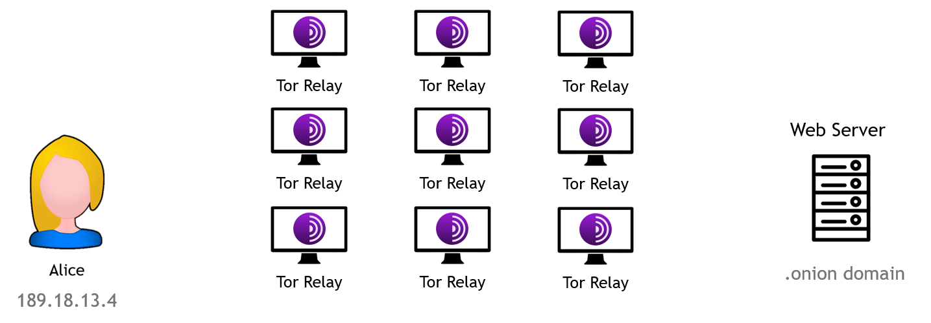
The Onion Router (Tor)

Slide 23
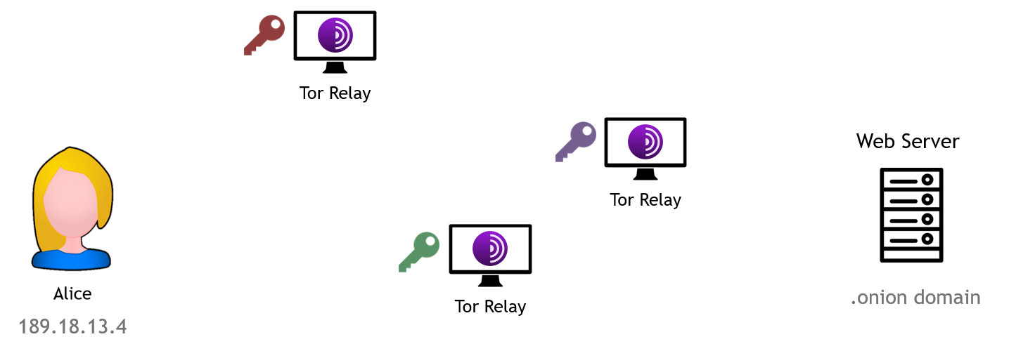
The Onion Router (Tor)

Slide 24
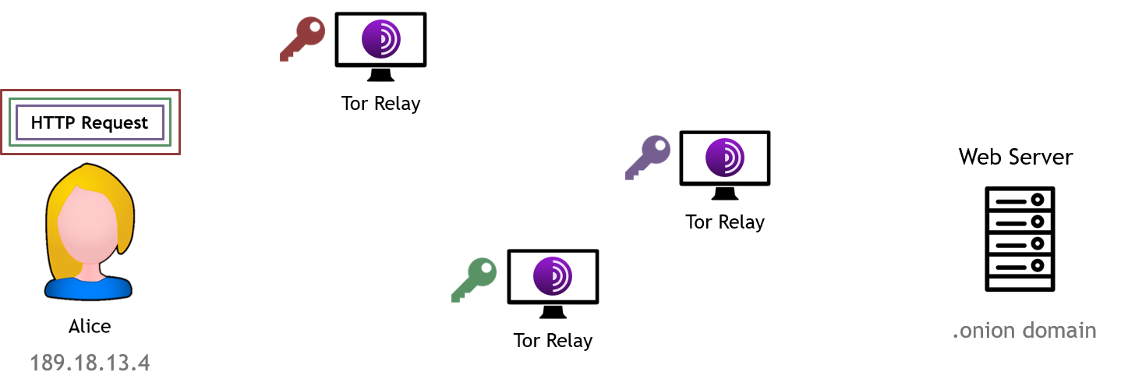
The Onion Router (Tor)

Slide 25
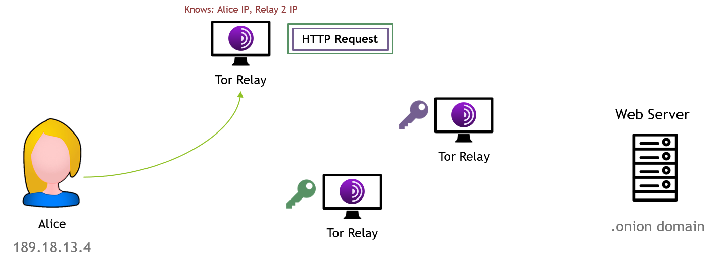
The Onion Router (Tor)

Slide 26
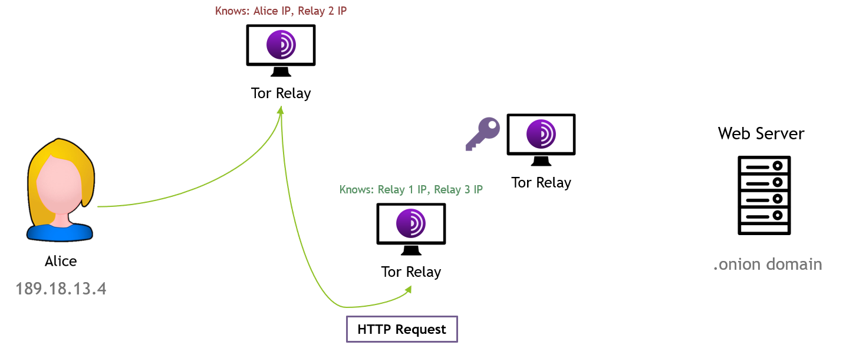
The Onion Router (Tor)

Slide 27
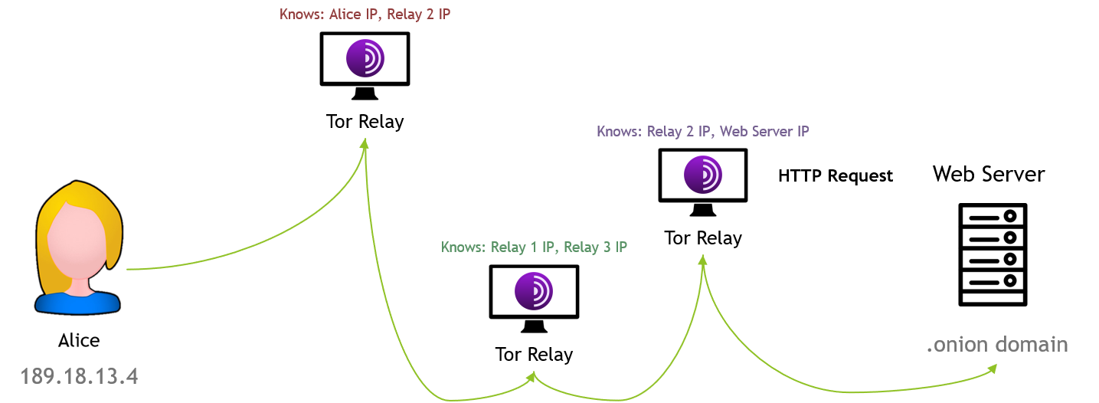
The Onion Router (Tor)

Slide 28
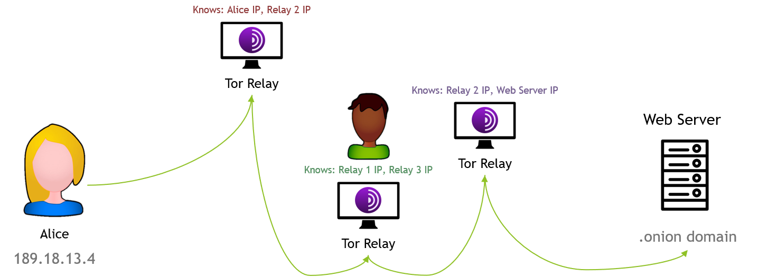
The Onion Router (Tor)

Slide 29
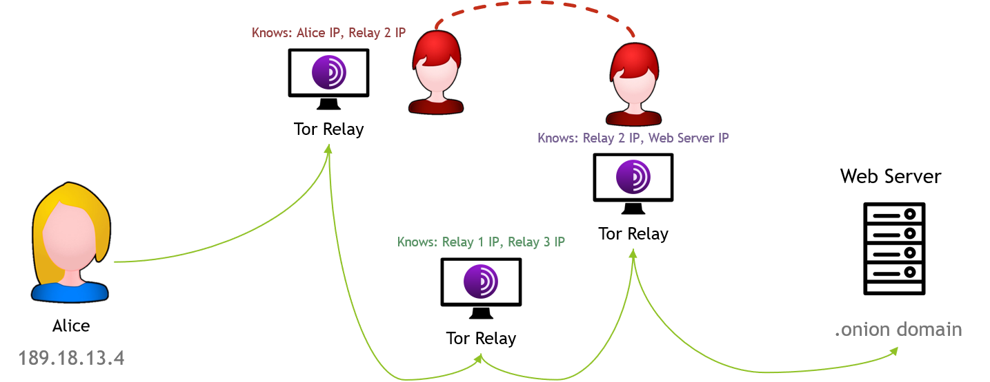
The Onion Router (Tor)

Slide 30
The Onion Router (Tor)
Chaum Mixing
Mixes packets between ‘hops’ so they are harder to trace from start to finish
Encryption
AES is used to encrypt packets in a Tor circuit, with Diffie-Hellmann Key Exchange
Public Key Cryptography is used for Hidden Services
Hidden Services
Tor allows users to setup hidden (‘onion’) services such as web servers and SSH servers, without exposing their IP address
These are the .onion domains you see on Tor - for example, https://protonirockerxow.onion
Hidden services are registered with a Hidden Service Directory, which is like a ‘phone book’ - it stores details of the hidden services’ IPs, and directs users to them via a rendezvous point
The keys for the dictionary are the onion address; the Hidden Service ‘descriptors’ consist of the IP address and a list of ‘introduction points’; the descriptor is signed with its private key

Slide 31
Tor Relay Nodes
Volunteer-run - about 6500 relay nodes
What each node knows
Previous and next node address
Inner nodes don’t know what point in the circuit they are
Entry nodes know the IP of the source
Exit nodes know the IP of the destination, and any unencrypted traffic content
Node Types
Guards - The ‘entry’ points into the network - computationally expensive to run
Exit - The final point in the circuit - malicious exits can be flagged with bad_exit
Bridge - An optional node that aren’t publicly listed (to prevent blocking)
Directory - Maintain a list representing the state of the network - centralised(ish)
HSDir - Hidden service directory nodes, forming a distributed hash table

Slide 32
Attacks Against Tor
Traffic Fingerprinting
Malicious Exit Nodes
Monitor traffic, examine its contents, and even redirect it
https://www.zdnet.com/article/a-mysterious-group-has-hijacked-tor-exit-nodes-to-perform-ssl-stripping-attacks/
Combine this with a malicious entry node...
HSDir Attacks
Controlling a majority share makes it possible to monitor HSDir requests, and provide false information
Blocking
Via Directory nodes
Via Deep Packet Inspection

Slide 33
Mitigations
HTTPS (again)
Protecting your traffic with an extra layer of encryption is always a bonus
See this page for a visual explanation: https://www.eff.org/pages/tor-and-https
Chaum Mixing mitigates against traffic analysis
Large number of nodes makes it difficult to guarantee control of both a guard and exit
Malicious nodes can be struck off the list of safe exits

Slide 34
Invisible Internet Project (I2P)
I2P is a Peer-to-Peer (P2P network)
P2P networks are decentralised topologies, which are often fully interconnected
They are designed to share resources (e.g. storage, bandwidth, processing power)
Examples include Napster and Windows 10 Content Distribution
I2P is volunteer-run, with around 55,000 nodes. It operates as an entirely separate layer to the internet, and ‘outproxying’ (i.e. ‘exiting’ traffic) to the internet is not advised (unlike Tor)
Garlic Routing
Similar to Onion Routing, in that multiple layers of encryption are applied (when both routing traffic and building ‘tunnels’)
Messages are also bundled together in ‘bulbs’, making traffic analysis harder
End to End Encryption is used throughout the network

Slide 35
Make Your Own!
As Tor, I2P, and many VPN / proxy solutions are open-source, it’s possible to host your own!
For proxies, the Arch Wiki has a nice set of information regarding software choice and setup
The most popular VPN solutions are OpenVPN, IPSec, and WireGuard
See this comparison of different VPNs for more information
For running your own Tor node, there is a wealth of information on the Relay Operations page
Today we’ll be setting up a WireGuard VPN server!

Slide 36
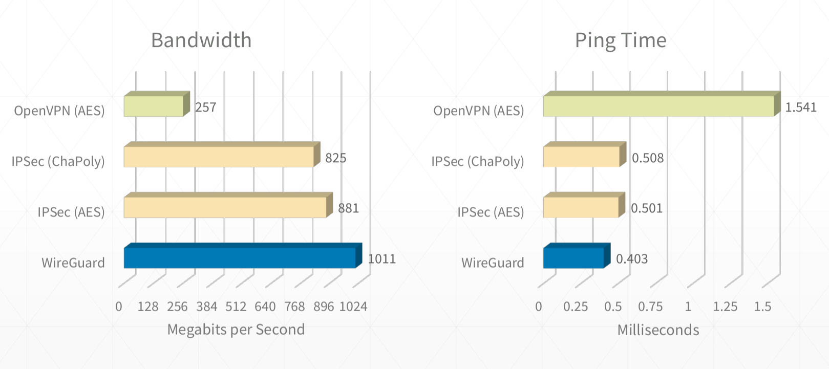
Why WireGuard?
The setup is easy, with only the keys needing to be shared + one simple conf
Uses modern and fast cryptography everywhere
Minimal attack surface (~4,000 lines of kernel code vs 600,000 for OpenVPN)
High performance

Slide 37
Creating a WireGuard Server
First, you’ll need a Linux machine to host the server on!
If you have a computer with a static IP or a dynamic DNS provider, you can use that
Otherwise, you could pick up a VPS from AWS, Linode, or Vultr
Then you’ll need to configure the WireGuard server!
My notes are available here
Some excellent (and more advanced) documentation can be found here
Set up your VPN peers to connect to the server
WireGuard offers clients for many platforms

Slide 38
Upcoming Sessions
Next week
The week after that
And the week after that
And the week after that
And the week after that
What’s up next?
www.shefesh.com/sessions

Slide 39

Any Questions?
www.shefesh.com
Thanks for coming!

